Slide 1


Vue JS
the ultimate frontend framework

Slide 2


$whoami.
Xavi Sánchez Mir
Fullstack developer at Tokiota
Universitat Politécnica de Catalunya
Universidad Politécnica de Madrid
@xavism9

Slide 3
about tokiota.
Software company in bcn & madrid
Microsoft technologies
4 departaments
70+ in Barcelona, 20+ in Madrid
Development Infrastructure
Sharepoint
Big Data
@tokiotait

Slide 4
agenda.
composing with components
data, props and methods
START
01
02
03
04
what is vuejs and cli
general syntax

Slide 5
agenda.
handling user inputs
template syntax
05
06
07
08
loops and conditionals
lifecycle hooks

Slide 6
agenda.
computed
routing
09
10
11
12
directives
watchers

Slide 7

agenda.
hands on
13
14
ROSES
dev tooling

Slide 8
01. what is vue js and cli.
Vue is a progressive framework for building user interfaces.
The core library is focused on the view layer only, and is easy to integrate
Vue is also perfectly capable of powering sophisticated Single-Page Applications.

Slide 9
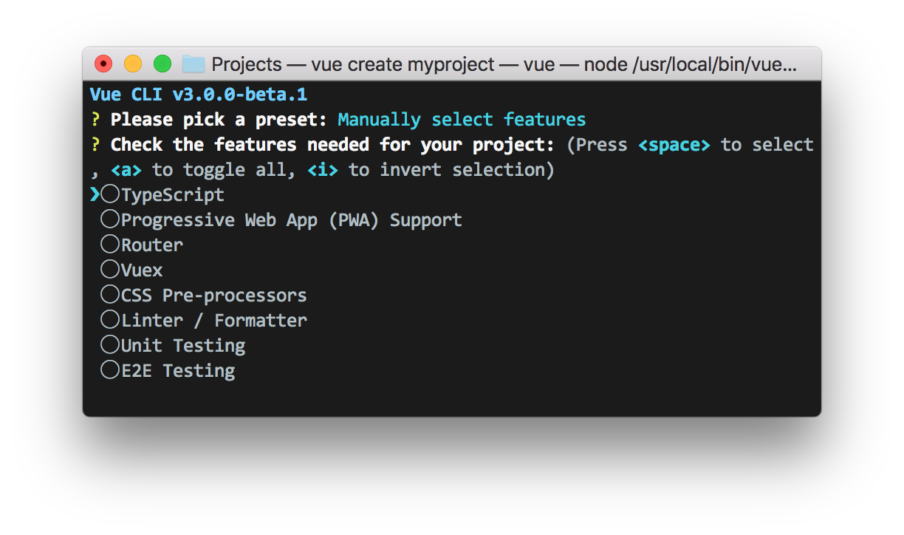
01. what is vue js and cli.
cli means command line interface, it allows us to create vuejs applications out of the box, without losing time in the configuration.
npm install @vue/cli
vue create project-name

Slide 10

01. what is vue js and cli.

Slide 11

02. composing with components.
Component-based, allows us to transform large apps into small, self-contained and often reusable components.

Slide 12
03. general syntax.
<template>
<div class="name">
</div>
</template>
<script>
export default {
name: 'ComponentName',
props: {
msg: String
}
}
</script>
<style scoped>
h3 {
margin: 40px 0 0;
}
</style>
template
scripts
style

Slide 13
04. data, props and methods.
export default {
name: 'HelloWorld',
data() {
return {
message: 'Hi!'
}
},
props: {
msg: String
},
methods: {
sayHi() {
console.log('Hi')
}
}
}

Slide 14
05. loops and conditionals.
<li v-for="(item, index) in items" :key=“index"></li>
<h1 v-if="ok">Yes</h1>
<h1 v-else>No</h1>

Slide 15
06. handling user inputs.
<button v-on:click="reverseMessage">Reverse Message</button>
v-on => @
@click (click.once, click.stop, click.capture)
@hover
@keyup, @keydown, @keypressed (keyup.13, keyup.ctrl, key.enter …)
v-on:ownEvent=“doWhatever"

Slide 16
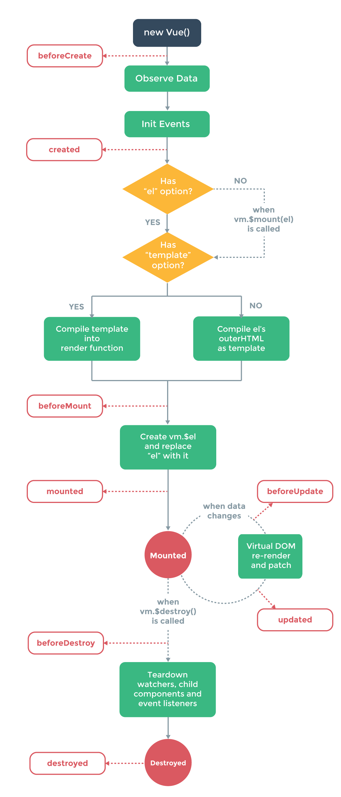
07. lifecycle hooks.

Slide 17
08. template syntax.
<p>Using mustaches: {{ rawHtml }}</p>
<p>Using v-html directive: <span v-html=“rawHtml"></span></p>
<p v-if=“conditional”></p>
<a v-bind:href="url"> ... </a>
<a :href="url"> ... </a>

Slide 18
09. directives.
Directives are special attributes with the v- prefix. Directive attribute values are expected to be a single JavaScript expression.
There are a set of created directives to use, but you can also create your own ones.
https://vuejs.org/v2/guide/custom-directive.html

Slide 19
10. computed.
<div id="example">
<p>Original message: "{{ message }}"</p>
<p>Computed reversed message: "{{ reversedMessage }}"</p>
</div>
<script>
computed: {
// a computed getter
reversedMessage: function () {
// `this` points to the vm instance
return this.message.split('').reverse().join('')
}
}
</script>

Slide 20
11. watchers.
<div id="example">
<p>Original message: "{{ message }}"</p>
</div>
<script>
watch: {
message: function () {
console.log('Your message has changed')
}
}
</script>

Slide 21
12. routing.
Create an SPA as simple as possible, just enjoy how it works
const routes = {
'/': Home,
'/about': About
}

Slide 22
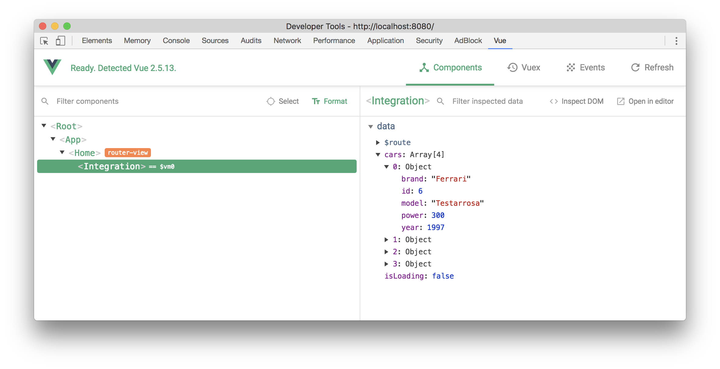
13. dev tooling.

Slide 23

14. hands on.

Slide 24


thanks for your attention.

